Slide 1
Unit Testing / Firebase Auth
Group Members
Hamza Khawaja
Abdullah Anwar
Salman Manzoor
Ali Hussnain

Slide 2

What is this?
Unit tests are the fundamental tests in your app testing strategy.
By creating and running unit tests against your code, you can easily verify that the logic of individual units is correct.
Running unit tests after every build helps you to quickly catch and fix software regressions introduced by code changes to your app.

Slide 3
Do I Need to Conduct Unit Testing?
The short answer is no.
The long answer is that it is a very good tool, though it isn’t necessary in all situations.
e.g
Your app is very small and simple.
You don’t plan your app to work in the long term and you need it only for a demonstration.
You’re a super-human who writes perfect code without any mistakes.

Slide 4

Important Questions
2 important questions one must ask when writing about tests
Question #1: Which parts of the app to test?
Question #2: What kind of tests to write for maximum efficiency?

Slide 5
Main Testing areas
The main user flows
Payments and Paid features
Parts that everyone is afraid to touch
Parts that are planned to be refactored
Fragile components, such as encryption, offline sync or complicated calculations

Slide 6
J-Unit Testing
JUnit is an open source Unit Testing Framework for JAVA. It is useful for Java Developers to write and run repeatable tests.
Initially developed by Erich Gamma and Kent Beck.
Used for Testing of a small chunk of code.

Slide 7
J-Unit Test Framework
JUnit is a Regression Testing Framework.
Used by developers to implement unit testing in Java, and accelerate programming speed and increase the quality of code.
JUnit Framework can be easily integrated with either of the following
1) Eclipse
2) Ant
3) Maven

Slide 8
Benefits of J-Unit Testing
It finds bugs early in the code, which makes our code more reliable.
J-Unit is useful for developers, who work in a test-driven environment.
Unit testing forces a developer to read code more than writing.
You develop more readable, reliable and bug-free code which builds confidence during development.

Slide 9
Where should the test be located?
Typical, unit tests are created in a separate project or separate source folder to keep the test code separate from the real code. The standard convention from the Maven and Gradle build tools is to use:
src/main/java - for Java classes
src/test/java - for test classes

Slide 10
JUnit Annotations | Description
import org.junit.* | Import statement for using the following annotations.
@Test | Identifies a method as a test method.
@Before | Executed before each test. It is used to prepare the test environment (e.g., read input data, initialize the class).
@After | Executed after each test. It is used to cleanup the test environment (e.g., delete temporary data, restore defaults). It can also save memory by cleaning up expensive memory structures.
@BeforeClass | Executed once, before the start of all tests. It is used to perform time intensive activities, for example, to connect to a database. Methods marked with this annotation need to be defined as static to work with JUnit.
@AfterClass | Executed once, after all tests have been finished. It is used to perform clean-up activities, for example, to disconnect from a database. Methods annotated with this annotation need to be defined as static to work with JUnit.
@Ignore or @Ignore("Why disabled") | Marks that the test should be disabled. This is useful when the underlying code has been changed and the test case has not yet been adapted. Or if the execution time of this test is too long to be included. It is best practice to provide the optional description, why the test is disabled.
@Test (expected = Exception.class) | Fails if the method does not throw the named exception.
@Test(timeout=100) | Fails if the method takes longer than 100 milliseconds.

Slide 11
DEMO

Slide 12

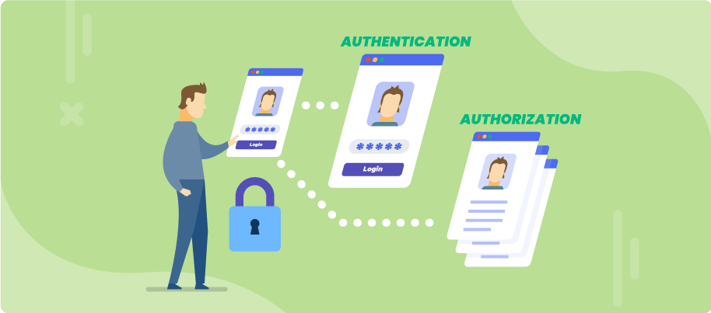
Firebase Authentication
Have you ever Build your own Authentication System?

Slide 13
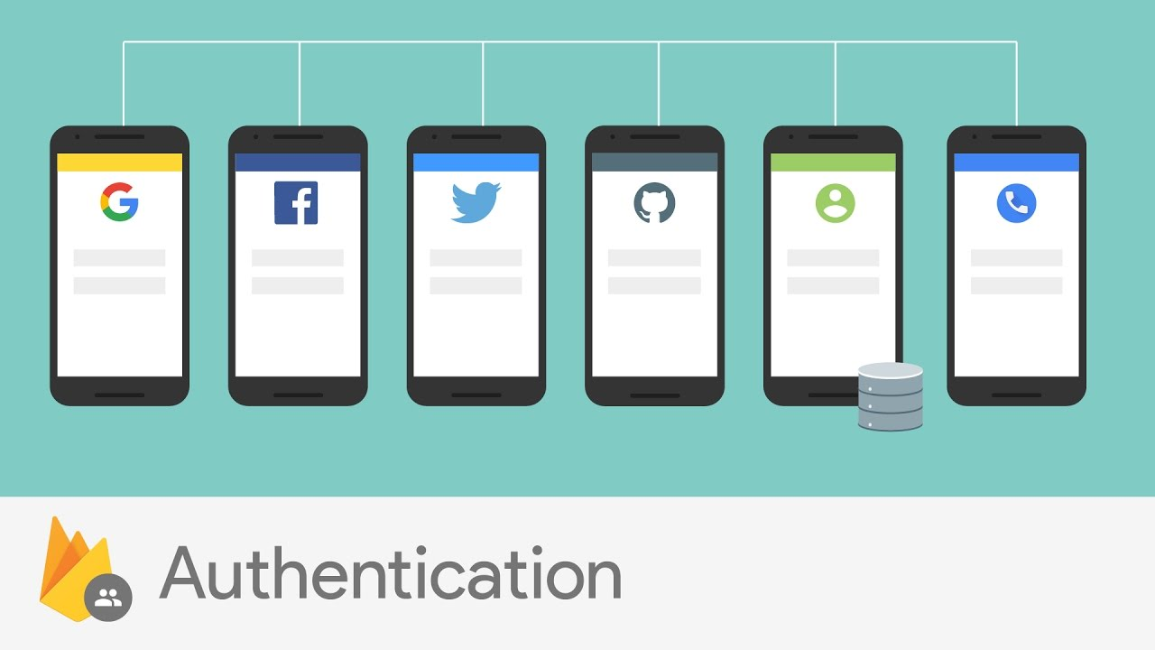
Firebase Auth
What is Firebase Auth?
Why we used Firebase Auth?

Slide 14

How This Work?
Connect your App with Firebase.
Enable Sign Up methods
That’s it

Slide 15
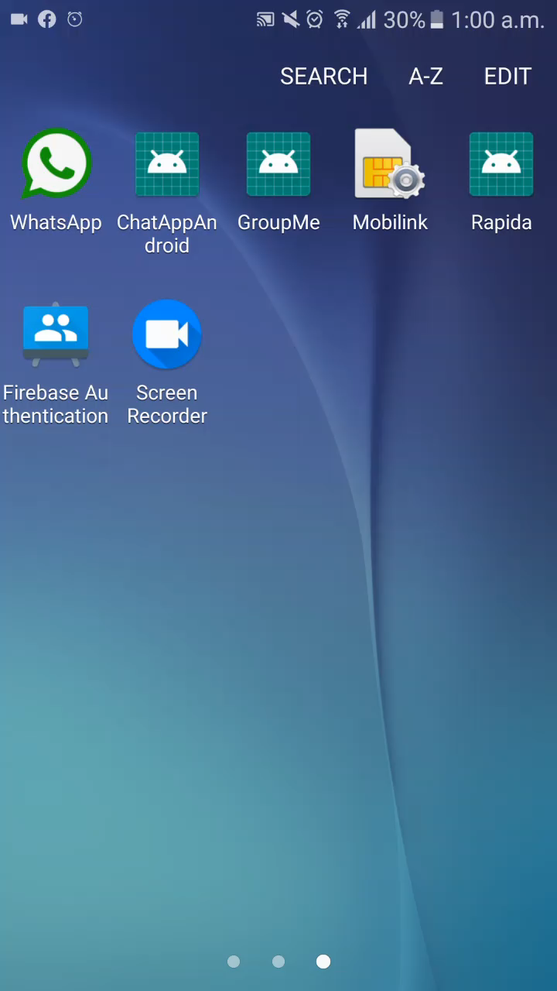
Demo

